Slide 1
The Sound of Silence
The Impact of Stigma on Addiction and Mental Illness and the Role of Advocacy in Counteracting the Effect

Slide 2
“We envision a society where people who are addicted to alcohol or other drugs, people in recovery from addiction, and people at-risk for addiction are valued and treated with dignity; and where stigma, accompanying attitudes, discrimination and other barriers to recovery are eliminated. We envision a society where addiction is recognized as a public health issue – a treatable disease for which individuals should seek and receive treatment; and where treatment is recognized as a specialized field of expertise” (Changing the Conversation; The National Treatment Plan Initiative; November 2000).

Slide 3
Defining Terms:
Prejudice: A negative attitude about members of a certain group. To “pre-judge” someone.
Discrimination: Behavior resulting in differential treatment, usually of a negative nature.
Stereotypes: Fixed, generalized, and overly simplistic conceptions of traits, behaviors, and attitudes of a particular group of people.
Stigma: Severe social disapproval of personal characteristics or beliefs that are against cultural norms, often leading to marginalization.

Slide 4
Stigma exists when four specific components come together:
Differentiation and labeling: Identifying which human differences are important and worthy of labeling is a social process and requires a significant amount of oversimplification in order to create groups. Differences must be socially judged to be relevant for labeling to occur.
Linking to stereotypes: The labeled differences must be linked to stereotypes
Us and them: The linking of negative attributes to differentiated groups facilitates a sense of separation between the “us” and the “them.” This implies that the labeled group is slightly less human in nature, and at the extreme, not human at all.
Disadvantage: As individuals are labeled and linked to undesirable characteristics, status loss and discrimination occur in areas including income, education, mental well-being, housing, health, and medical treatment.
Link and Phelan (2001)

Slide 5
How stigma impacts:
In Changing the Conversation (2000), stigma was addressed as a “powerful, shame-based mark of disgrace and reproach that impedes treatment and recovery.”

Slide 6
Stigmatized individuals may internalize negative perceptions of themselves, further affecting their ability to effect positive change in their lives.
It can affect the individual’s confidence in their ability to seek treatment, remain in recovery, keep jobs, and trust the systems set up to help them.
They begin to accept the idea that their addiction is their own fault and they may be too weak to do anything about it.
Hiding addiction becomes the “rational” thing to do when seeking help could result in losing a job or insurance or losing a child to DHS because the individual is declared an “unfit parent” because of drug or alcohol addiction.
As a social justification for giving up on people, stigma pushes public policy away from a medical response to addiction and toward punishing its symptoms.

Slide 7
Stigma wants us to believe that people with addictions are not only bad, but also weak and failures at life. It focuses all of our attention on mistakes and self-defeating behaviors.

Slide 8
The task is to help shift individuals struggling with addiction away from their self-stigmatizing focus on their imagined worthlessness, and to open them up to the sources of strength and hope that they already have. This requires an approach and interactions that are focused on the individual’s resiliencies and strengths, on solutions rather than problems.

Slide 9
What is addiction?
Addiction is a brain disease characterized by:
Compulsive behavior
Continued abuse of drugs despite negative consequences
Persistent changes in the brain’s structure and function

Slide 10
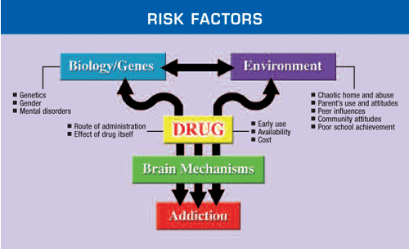
Why do some people become addicted to alcohol and drugs, while others don’t?
As with any other health condition, vulnerability to addiction differs for each individual. There are certain risk factors that make addiction more likely.

Slide 11
The Science of addiction
There is a growing body of evidence that the brains of some individuals are simply more vulnerable to the effects of alcohol and drugs. Several factors contribute to this vulnerability:
Genetics (may account for up to 60% of vulnerability to addiction)
Early developmental influences and environmental factors
Effects of stressful life events across a person’s life
Mental disorders, such as depression or anxiety

Slide 12
The Brain and Addiction
The brain is both the organ controlling our behavior and our mind. The field of neuroscience studies how people control their behaviors, thoughts, and feelings, and how these actions can sometimes get out of control. Neuroscience is providing us with interesting new information about the science of addiction.
www.brainfacts.org

Slide 13
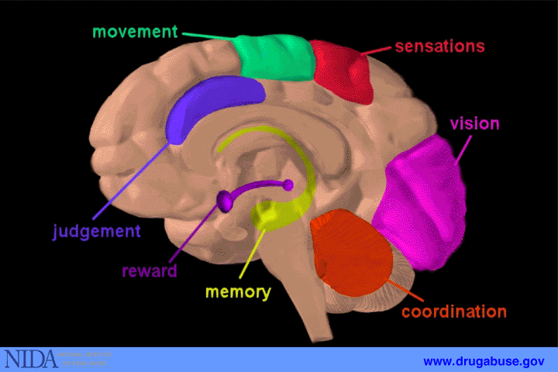

Slide 14
The human brain consists of several large regions with each one responsible for some of the activities necessary for life (Kandel, 1991). These include the brainstem, cerebellum, limbic system, diencephalon, and cerebral cortex. Specific areas of the brain control different functions, such as seeing and hearing, as well as areas that regulate emotions and motivations. The specific area regulating emotions is carried out by the part of the brain known as the limbic system. The limbic system uses memories, information about how your body is working, and current sensory input to generate your emotional responses to current situations.

Slide 15
The Brain’s Limbic System
The limbic system is involved in many of our emotions and motivations, particularly those related to survival such as fear and anger. The limbic system also regulates feelings of pleasure such as those associated with eating and sex. The feelings of pleasure, a part of our “reward system,” are very powerful. Drugs of abuse activate this reward system.

Slide 16
Within the system, the drugs share the ability to increase the levels of dopamine in the reward system. This almost certainly accounts for the rewarding effects of the drugs. At some point, the response to a given amount of drug will reach a plateau. Either a higher dose is needed or a different method of use that will get the drug to the brain more quickly.

Slide 17
Disruption to the brain’s reward system is only part of the reason why drug addictions are so difficult to overcome and why relapses can occur even after years of abstinence. Neuroscientists discovered drugs also alter connections in brain circuits that govern learning and memory, causing the formation of strong associations between the drug’s pleasurable sensation and the circumstances under which it was taken.

Slide 18
Memories appear to be a critical part of addiction:
The amygdala is a part of the brain’s limbic system which is critical for memory and responsible for evoking emotions.
For someone with addiction, when a drug craving occurs, the amgdala becomes active and a craving is triggered.
PET scans show that, in someone with a history of addiction, when presented with pictures of the drug or paraphenalia, the amygdala becomes very active.
This craving demands the drug immediately. Rational thoughts are dismissed. A basic change has occurred in the brain.
Addiction is a brain disease!

Slide 19
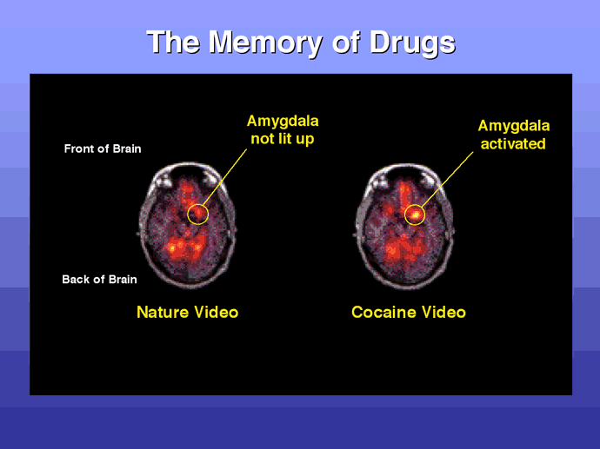

Slide 20
So what about the behavioral effects?
It seems natural to expect that, when individuals have experienced major problems due to drugs, they can just “wake up” and quit using.
However, the areas of the brain that do self-reflection, assessment, planning and careful listening to feedback are the areas most damaged by the substance use.
The drug use impairs the part of the brain necessary to invent solutions to problems, both short term and in the longer term.
Thus, the very thing that we are asking the individual to do is the one thing they will have the greatest difficulty doing.

Slide 21
Are the changes from drug use permanent?
Yes and no.
There is increasing evidence of brain recovery from addiction.
Long term heavy alcohol use results in some permanent damage and alcohol is perhaps the most harmful drug to the central nervous system. However, much of the damage can either be restored or the brain can develop compensations for damaged areas.
However, fundamental neurochemical “imbalances” that were present before the addiction may still need attention.

Slide 22
What is required for recovery?
An understanding of co-occurring conditions such as depression, anxiety, and trauma.
Accessible treatment professionals.
Availability of resources
Respect for the individual’s autonomy
Understanding of relapse
Active use of recovery supports
An understanding that addiction is as chronic health condition
An appreciation of how difficult the journey of recovery can be

Slide 23
The bottom line:
Individuals make choices to begin using drugs. This voluntary initiation into the world of addictive drugs has strongly influenced society’s view of drug abuse, drug addiction, and its treatment.
When drug abuse becomes drug addiction, however, there is a loss of control over the drug use and it is no longer a matter of choice.
Craving arises from the brain’s need to maintain a state of homeostasis that now includes the presence of the drug.
Using PET imaging, scientists have shown that cravings have a physical basis in the brain (Childress, Mozley, Elgin, Fitzgerald, Reivich, & O’Brien, 1999).

Slide 24
The bottom line:
Drug abuse and addiction lead to long-term changes in the brain. While the biological foundation for drug addiction does not absolve an individual from the responsibility of his or her actions, the stigma of drug addiction needs to be lifted so individuals can receive proper medical treatment, similar to other chronic diseases.
Addiction is a recurring chronic disease While no cure is currently available, effective treatment is.
Successful treatment for any chronic disease necessitates patient compliance with the prescribed treatment regimen.
Adhering to a treatment plan is difficult for those with chronic disease. Treatment for drug addiction is statistically more successful than for other chronic diseases (such as heart disease, hypertension, asthma sufferers, etc.), but relapses happen (O’Brien & McClellan, 1998).
Just saying “no” is unrealistic. It would be comparable to telling someone with diabetes to “just get over it.”
Treatment may include medications (Naltrexone, Vivitrol, Campral, Antabuse, Suboxone, anti-depressants, etc.) to help the brain re-establish equilibrium.
The idea of “moral deficiency” is inappropriate and stigmatizing.

Slide 25
Further reading
Kenny, P.J. (2007). Brain reward systems and compulsive drug use, Trends in Pharmacological Sciences, 28(3):135-141.
Koob, G.F., Volkow, N.D. (2010). Elaboration of reward circuitry in brain that mediates responses to natural rewards (food, sex) under normal conditions and how this circuitry is corrupted by chronic exposure to drugs of abuse. Neuropsychopharmacology, 35(1):217-238.
Volkow, N.D., Li T.K. (2004). Drug addiction: The neurobiology of behavior gone awry. Nature Reviews Neuroscience. 5:963-970.

